Slide 1
Computer Troubleshooting
Advanced Techiniques

Slide 2
What’s on tap today
Explorer.exe
Run
Regedit
MSConfig
Task Manager

Slide 3
Explorer.exe
The program that shows you everything
Seriously!!!

Slide 4
With Explorer.exe

Slide 5
Without Explorer.exe

Slide 6
Without Explorer.exe
No Taskbar
No Desktop
No Way to Navigate Files
If this ever happens on your computer, then you need to “Run” Explorer.exe

Slide 7
Run

Slide 8
Run
Used to execute programs (.exe)
Related to MS-DOS
Double Clicking a file does the same thing
Have to have the exact location to load most files
Some exceptions:
Explorer
MSConfig
Regedit
Taskmgr

Slide 9
Registry
How to edit

Slide 10
Registry
Stores settings and options for the system
Used by most programs
Removing viruses often requires registry editing
Use REGEDIT.EXE to edit the registry

Slide 11
RegEdit.exe

Slide 12
MSConfig
Allows control of startup

Slide 13
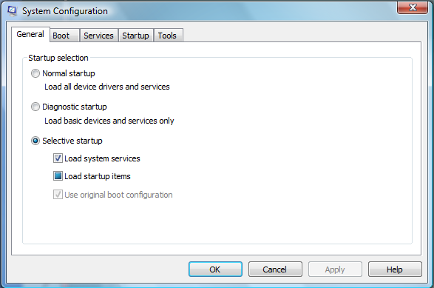
MSConfig.exe
System Configuration Utility

Slide 14
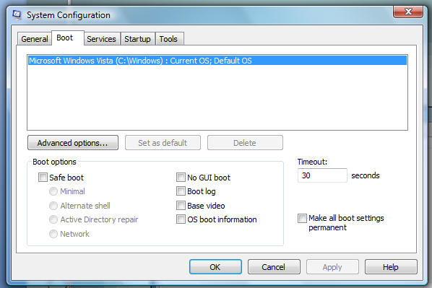
MSConfig
Can specify boot instructions

Slide 15
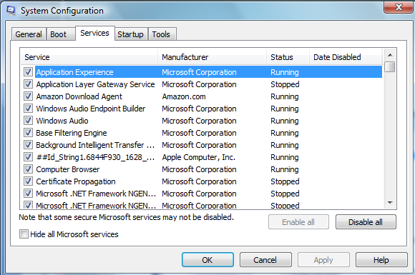
MSConfig
Can disable unneeded services

Slide 16
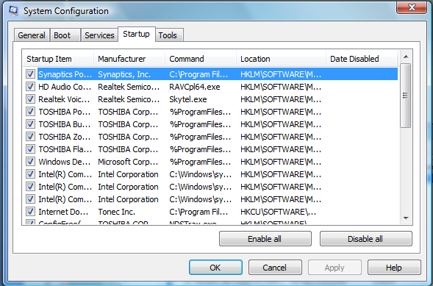
MSConfig
See a list of programs that automatically start

Slide 17
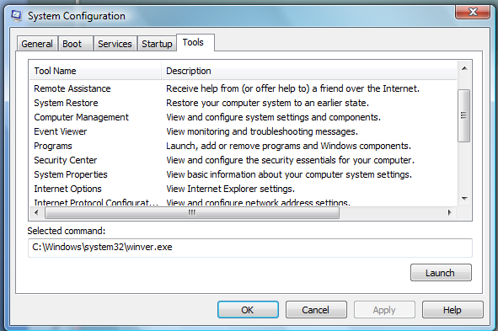
MSConfig
Launch useful tools

Slide 18
MSConfig
System Configuration Utility
Accessed by using Run…
Type MSConfig

Slide 19
Task Manager
One program to rule them ALL!

Slide 20
Task Manager
Accessed by Ctrl + Alt + Del
Also, right click the taskbar
Or, via Run…

Slide 21
Task Manager
Allows you to close any program currently running on your system
Provides important information about programs
View the way the computer is being used
Examine programs that you did not open

Slide 22
Task Manager
Shows visible programs that are currently running
Can “End Task” or “Switch To”

Slide 23
Task Manager
Kills processes
Allows changing priority or affinity
Affinity is involved when you have more than one processor in your computer

Slide 24
Task Manager
View how the system is being used

